Slide 1
Unit B
Resident Care Skills
Essential Standard NA6.0
Understand nurse aide skills needed to provide for residents’ nutrition, hydration, and elimination needs.
Indicator 6.01
Understand nurse aide skills needed to provide for residents’ nutrition and hydration needs.
Understand nurse aide skills needed to provide for residents’ nutrition and hydration needs.

Slide 2
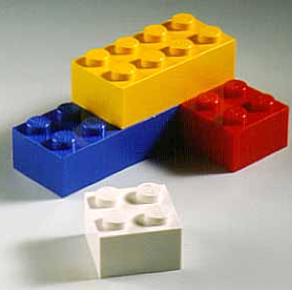
*Nutrients
Food is broken down by the gastrointestinal system into small substances called nutrients.

Slide 3
*Nutrients
Protein-builds and repairs tissue
Vitamins-help carry out specific body functions
Carbohydrates-supplies fuel and fiber
Minerals-same as vitamins
Fats-stored energy, body heat, protects organs
Water-most essential nutrient for life

Slide 4
*Food Group
A food group is a collection of foods that share similar nutritional properties or biological classifications.

Slide 5

Vegetable Group
*Make half your plate fruits and vegetables.
Vary your vegetables.

Slide 6
Calories
A calorie is a unit of energy.

Slide 7
*Empty Calories
Calories contained in food that provide “fuel” but few or no nutrients.

Slide 8

*Signs of Good Nutrition
Healthy, shiny looking hair
Clean skin and bright eyes
A well-developed, healthy body
An alert facial expression
An even, pleasant disposition

Slide 9
*Nutritional Challenges of Geriatrics
Metabolism slows muscles weaken body moves slow activity is reduced reduced activity decreases appetite.

Slide 10
*Nutritional Challenges of Geriatrics
Less saliva production affects chewing and swallowing.

Slide 11
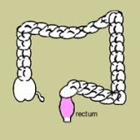
*Nutritional Challenges of Geriatrics
Constipation interferes with appetite.
X

Slide 12
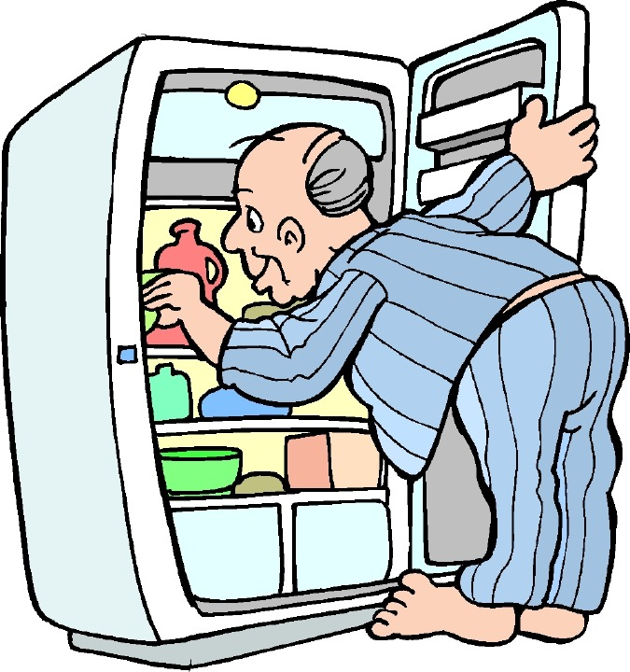
*Factors Influencing
Dietary Practices
Personal preference
Appetite
Finance
Illness
Culture

Slide 13

Muslim/Moslem - avoid alcohol, pork products
*7th Day Adventist - avoid coffee/tea, alcohol, pork and some meats, caffeine

Slide 14
*Conservative Jewish faith
  Prohibits shellfish, non-kosher meats such as pork
  Requires special utensils for food preparation

Slide 15
*Therapeutic, Modified or Special Diets
Help body organs to maintain and/or regain normal function
Treat metabolic disorders by regulating amount of food

Slide 16
*Diet Cards
List:
the resident’s name
Information about special diets
Food allergies
Likes and dislikes

Slide 17
*Low-Fat/Low-Cholesterol Diets
Residents with high levels of cholesterol, gall bladder disease, diseases that interfere with fat digestion, and liver disease may be placed on these diets.
Diets permit skim milk, low fat cottage cheese, fish, white meat of turkey and chicken, veal, and vegetable fats. Use of monounsaturated fats such as olive oil, canola, and peanut oils are encouraged.
Do not offer additional fluids or foods that contain fluids. Notify the nurse if the resident complains of thirst.
Common abbreviation is “Low-Fat/Low-Chol”
*LSNFS-no saturated fats

Slide 18
*Dietary Management of Diabetes
Meal tray may contain artificial sweeteners
Common abbreviations for diabetic diets are “NCS” no concentrated sweets and the amount of calories allowed followed by “ADA” (American Diabetic Association)

Slide 19
Liquid Diets
Ordered short term for medical condition or before or after a test or surgery.
Liquid food is anything that is in the liquid state at room temperature.

Slide 20

*Liquid Diets
“Clear Liquids”
  Clear juices
  Broth
  Gelatin
  Popsicles
“Full Liquids”
Clear liquids plus:
Cream soups
Milk
Ice cream

Slide 21
*Pureed Diets
This diet does not require that a resident chew his/her food.
Food is chopped, blended, or ground into a thick paste of baby food consistency.

Slide 22

Nurse Aide Responsibilities in Serving Therapeutic Diets
Serve the RIGHT resident the RIGHT tray containing the RIGHT therapeutic diet at the RIGHT temperature in the RIGHT environment with the RIGHT attitude.

Slide 23
Parenteral Fluids
(*Intravenous Infusion - IV)
Fluids administered through vein. IVs help hydrate but have little nutritional value
Responsibility of licensed nurse

Slide 24
*Enteral Feeding
Liquid formula administered into the stomach through a tube by licensed nurse
Nose to stomach - nasogastric tube
Directly into stomach – gastrostomy tube - “PEG tube” (Percutaneous Endoscopic Gastrostomy)
Mitts may be ordered to prevent resident from dislodging tube

Slide 25


*Fluid Needs
Under normal conditions:
Eight 8-ounce glasses of water/fluids a day
64 ounces daily

Slide 26

*Fluid Imbalances
Edema – too much fluid in the body
Dehydration – too little fluid in the body

Slide 27
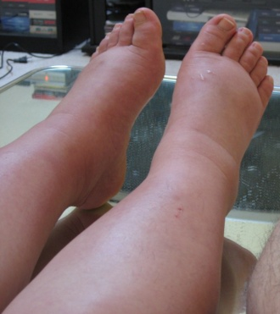
*Edema
Fluid intake exceeds fluid output - fluid retention
  Caused by:
    Kidney or failure
    Heart failure
    Excessive salt intake

Slide 28
*Dehydration
Fluid output exceeds fluid intake
Common problem of long-term care residents

Slide 29
*Dehydration
Causes of dehydration
  poor fluid intake
  diarrhea
  bleeding
  vomiting
  excessive perspiration

Slide 30
Special Fluid Orders
Force Fluids “FF” means to encourage the resident to drink more fluids.
Restrict Fluids “RF” means to limit the amount of fluids to the amount set by the physician.
NPO means nothing by mouth
Thickened liquids help prevent choking

Slide 31
Special Fluid Orders
*THICKENED LIQUIDS
Improves the ability to control fluids in the mouth and throat. For residents with swallowing problems.
If ordered, must be used with all liquids.
Do not offer water, water pitcher, or other liquids to a resident who must have thickened liquids.
Three basic consistencies are:
  Nectar thick; like a thick juice such as tomato
  Honey thick; pours slowly like honey
  Pudding thick; must be consumed with spoon

Slide 32

What is
*pagophagia?

Slide 33
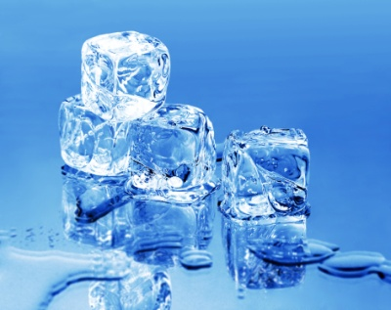
Pagophagia
*Ice craving is a condition called pagophagia, or compulsive eating of ice. This is a form of pica, a condition in which people crave and eat non-food substances like ice, chalk, paper, laundry soap, starch, hair, dirt, clay, or paint.
There are several reports linking the craving of ice to iron-deficiency anemia (low blood count as a result of an iron-deficiency). In fact, there’s even website called “All About Chewing Ice,” which also has a support group for people with this condition.
Residents often crave ice.

Slide 34
REMEMBER
    *30 ml = 1 ounce
30
20
10

Slide 35
*Preparing Residents for Meals
All residents clean and dressed for meals
Hair combed
Oral care provided
Encourage to use bathroom or urinal/bedpan
Cleanse and dry incontinent residents

Slide 36
Preparing Residents for Meals
Resident’s face and hands washed before meal – rewash residents’ hands and mouth after meals
Provide for comfort
  Raise head of bed
  Position in chair
  Transport to dining area
Provide clothing protector if appropriate

Slide 37
*General Guidelines
Assisting with Meals
Orient blind residents to food placement on the plate according to face of clock
Approach residents from non-effected side
Alternate fluid and food

Slide 38
*General Guidelines
Assisting with Meals
Remove tray when meal finished
Tell nurse is not eating
Observe and record amount eaten in %
Record fluid intake if ordered
Assist to position of comfort

Slide 39
Unit B
Nurse Aide Resident Care Skills
Essential Standard NA6.00
Understand nurse aide skills needed to provide for residents’ nutrition, hydration, elimination, and urination needs.
Indicator 6.02
Understand nurse aide skills needed to provide care for residents' elimination and urination needs.
Understand NAI skills needed to provide care for residents' elimination and urination needs.

Slide 40
6.02 Introduction
Elimination is the process of expelling solid wastes made up of the waste products of food that are not absorbed into the cells of the body.
Urination is the passage urine from the bladder to the outside of the body. Urine is made up of water and waste products filtered from the blood by the kidneys.

Slide 41
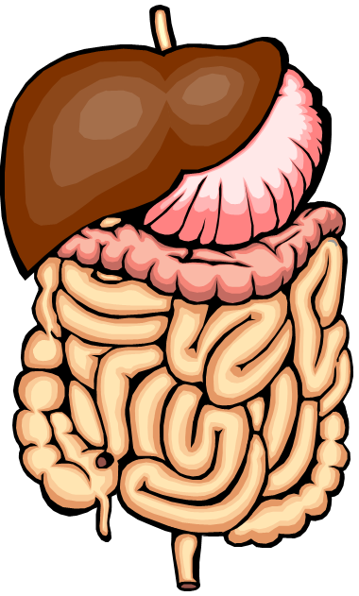
*Digestive System – Accessory Organs
  Liver – produces bile for breakdown of fats
  Gallbladder – stores bile produced by liver
  Pancreas - manufactures insulin and digestive enzymes

Slide 42
*Digestive System – Common Diseases
Ulcer - a lesion or erosion of the lining of the stomach or small intestine
Hepatitis – inflammation of the liver
Cirrhosis – chronic disease of liver where scar tissue replaces liver tissue
Cholelithiasis - stones in the gallbladder

Slide 43
*Digestive System – Common Diseases
Cancer - may occur anywhere along digestive tract
Hernia – protrusion of organ through wall of cavity where it is normally contained

Slide 44
Digestive System – Common Diseases
Diarrhea – watery bowel movements
Constipation - difficulty in expelling fecal material; incomplete or infrequent bowel movements- severe constipation leads to a FECAL IMPACTION
Hemorrhoids - enlarged veins in anal area Care Point

Slide 45
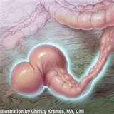
Digestive System – FECAL IMPACTION

Slide 46
✴ Be extra careful when inserting a thermometer, enema tip, or when cleaning the rectal area of a resident with hemorrhoids!

Slide 47
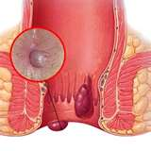
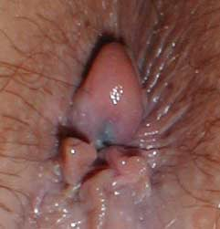
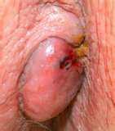
Hemorrhoids

Slide 48
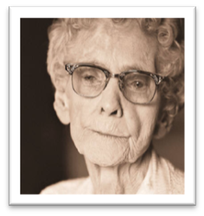
*Digestive System – Changes Due to Aging
Loss of teeth and decreased number of taste buds
Decrease in amount of digestive enzymes and saliva production
Difficulty chewing and swallowing
Altered taste and smell
Decreased appetite

Slide 49

Digestive System – Observations
Stool color and consistency
Abdomen – flat or distended
Date/time of last bowel movement
Nausea and/or vomiting

Slide 50

Blood in emesis or stool
Complaint of pain in stomach
Difficulty swallowing
Poor appetite
Constipation and/or diarrhea

Slide 51
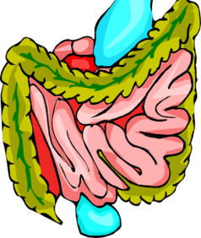
Bowel
Retraining

Slide 52
Digestive System – Bowel Retraining
*Incontinence: Inability to control defecation
  Embarrassing for resident
  Uncomfortable

Slide 53


*Digestive System – Bowel Retraining
Participants in plan
  resident
  family
  all staff members

Slide 54
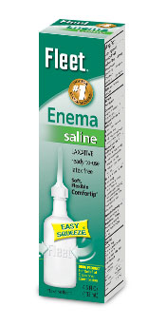

*Bowel Retraining - Guidelines
Enemas may be ordered by physician and given by nurse aide, as directed by supervisor
Regular, specific times to evacuate bowels established
Fluids encouraged on regular basis

Slide 55

Offer bedpan on set schedule
Assist to bathroom when request is made
Provide privacy
Display unhurried attitude

Slide 56
  Offer warm drink
  Be patient
  Encourage with positive remarks
  Do not scold when accidents happen (this is verbal abuse)
  Check on resident frequently

Slide 57
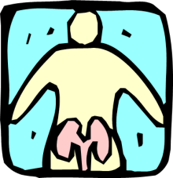
*Urinary System - Functions
  Filters waste products from blood
  Produces urine
  Aids in maintenance of water balance
  Regulates acid-base balance of body
  Stores urine until passed from body

Slide 58

Urinary System
*Characteristics of Normal Urine
Pale yellow to amber
Clear (not cloudy)
Acidic / pH 5.0 – 7.0
Quantity (output) 1000-1500 ml. per day

Slide 59
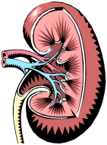
*Urinary System
Common Disorders
Nephritis - inflammation of kidney due to infection
Cystitis - inflammation of urinary bladder due to infection
Calculi – kidney or bladder stones

Slide 60
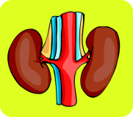
Urinary System
Common Disorders
Kidney failure – decreased ability of kidney to filter waste products from the blood
Urinary incontinence -inability to control urination

Slide 61
Complaint of burning on urination
Incontinence
Polyuria - excessive amounts of urine per voiding

Slide 62
*Hematuria - blood in urine
Nocturia – excessive urination at night
Urine having strong odor or cloudy appearance
Voiding small amounts of urine frequently

Slide 63
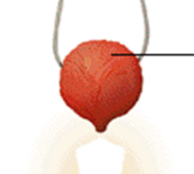
Urinary Bladder Retraining

Slide 64

Urinary System
Bladder Retraining
Individualized plan includes:
  schedule that specifies time and amount of fluids to be given
  schedule for attempting to void

Slide 65
Urinary System
Bladder Retraining Guidelines
Get resident’s cooperation
Record incontinent times
Provide with opportunities to void:
  when resident awakens
  one hour before meals
  every two hours between meals
  before going to bed
  during night, as needed

Slide 66

Urinary System
Bladder Retraining Guidelines
Provide stimuli as needed:
  run water in sink
  pour water over perineum
  offer fluids to drink
  place hands in warm water

Slide 67
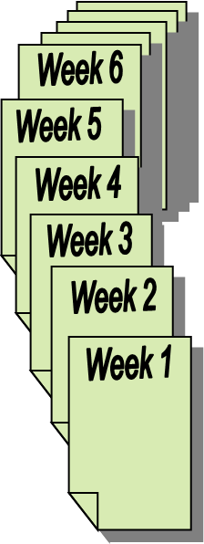
Urinary System
*Bladder Retraining Guidelines
Provide good skin care to prevent skin breakdown
Retraining may take 6-10 weeks
  be patient
  be supportive
  ignore accidents
  respect resident’s feelings

Slide 68
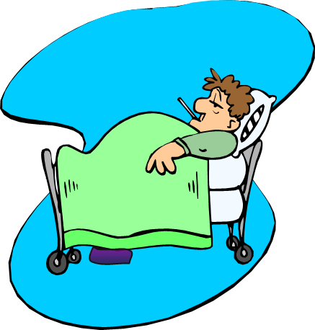
Indwelling Catheters
Increased Risk of Urinary Tract Infections
  Urinary meatus and surrounding area must be kept clean
  Catheter care given at least daily and PRN

Slide 69

When measuring urinary output note color, odor and appearance of urine.

Slide 70
Collecting a routine urine specimen

Slide 71
Other Types of
*Urine Collections
Clean Catch Urine Specimen
24-Hour Urine Collection
Straining Urine for Stones

Slide 72
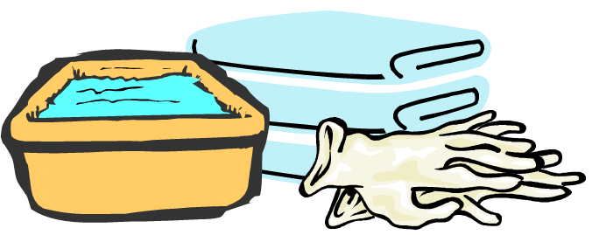
Clean Catch Urine Specimen
AKA: Mid-Stream Specimen
Cleansing of perineum prior to collection of urine reduces number of microbes that may contaminate specimen

Slide 73

Clean Catch Urine Specimen - Procedure
Follow standard precautions
Assure resident’s perineum is cleaned prior to collection
Instruct resident to begins voiding into appropriate receptacle and stop midstream
Place container in urine stream and collect specimen

Slide 74
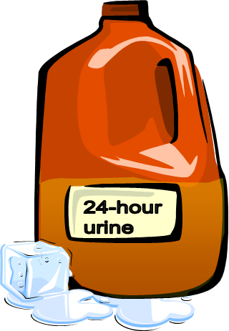
24-Hour Urine Collection
All urine voided in 24-hour period collected
  Urine chilled on ice to prevent growth of microorganisms
  Some tests may require preservative
  Urine usually collected in dark colored gallon jug

Slide 75

24-Hour Urine Collection
Imperative that resident and staff understand procedure and exact time period for urine collection

Slide 76
24-Hour Urine Collection - Procedure
  Follow Standard Precautions
  Begin test with resident’s bladder empty
  Discard first voiding
  Collect all voidings for next 24 hours
  Restarted collection with new gallon jug if test is interrupted

Slide 77

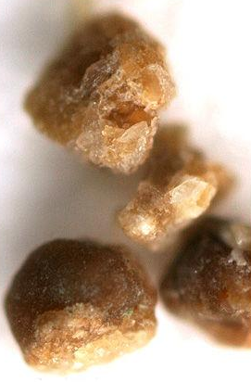
Straining for Kidney Stones

Slide 78
Condom Catheters

Slide 79
Observe penis for reddened or open areas and report to supervisor prior to new condom being application.

Slide 80
The Endocrine System
*Endrocrine System
affects the function of the
Urinary System
and other body functions

Slide 81
*Diabetes Mellitus
The most common disorder of the endocrine system.

Slide 82
*Diabetes Mellitus
  USA has highest morbidity and mortality rates
  Disorder of carbohydrate metabolism with decreased insulin production from pancreas

Slide 83
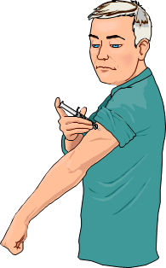
*Diabetes Mellitus
Uncontrolled diabetes leads to damage to eyes, kidneys, circulation
Diabetes characterized by consistent, elevated blood glucose levels requiring oral medication to stimulate pancreas or insulin injections

Slide 84
Diabetes Mellitus
L
Hypoglycemia
W
Low blood sugar

Slide 85
Diabetes Mellitus
lavated
Hyperglycemia
High blood sugar

Slide 86
 END 
6.02
Understand nurse aide skills needed to care for residents' elimination and urination needs.

