Slide 1
Healthcare Systems/Beliefs
In the U.S. the biomedical healthcare system is the “Western” system which bases the cause of disease on microorganisms, diseased cells and the aging process.

Slide 2
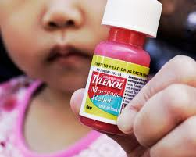
Healthcare Systems/Beliefs
Ways to eliminate the cause of illness:
Encourage patients to learn about their illness.
Inform patients about terminal diseases.
Teach patients self-care.
Use medications and technology to cure or decrease the effects of disease.
Teach preventative care.

Slide 3
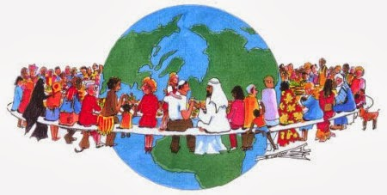
Healthcare Beliefs
Different cultures have different beliefs about health care, however, health care workers must remember that not all people within that culture follow all the customs of that culture.

Slide 4
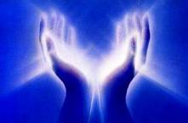
Healthcare Beliefs
Hispanic, Asian, Middle Eastern cultures believe that illness has a spiritual connection, They believe that health is a reward from God; health is a spiritual harmony.

Slide 5
Healthcare Beliefs
Alternative healthcare therapies are increasing in the U.S. More Americans are going to the chiropractor, homeopaths, naturopaths, hypnotists.

Slide 6
Healthcare Beliefs
All individuals have the right to choose the type of health care system and method of treatment they feel is best. The health care worker should talk to the patient to determine their health care preferences.

Slide 7
Healthcare Beliefs
Spirituality and religion are essential parts of every cultural group.
*Spirituality-the beliefs that people have about the purpose of life, their belief in a higher power and their need to find meaning and purpose in life.

Slide 8
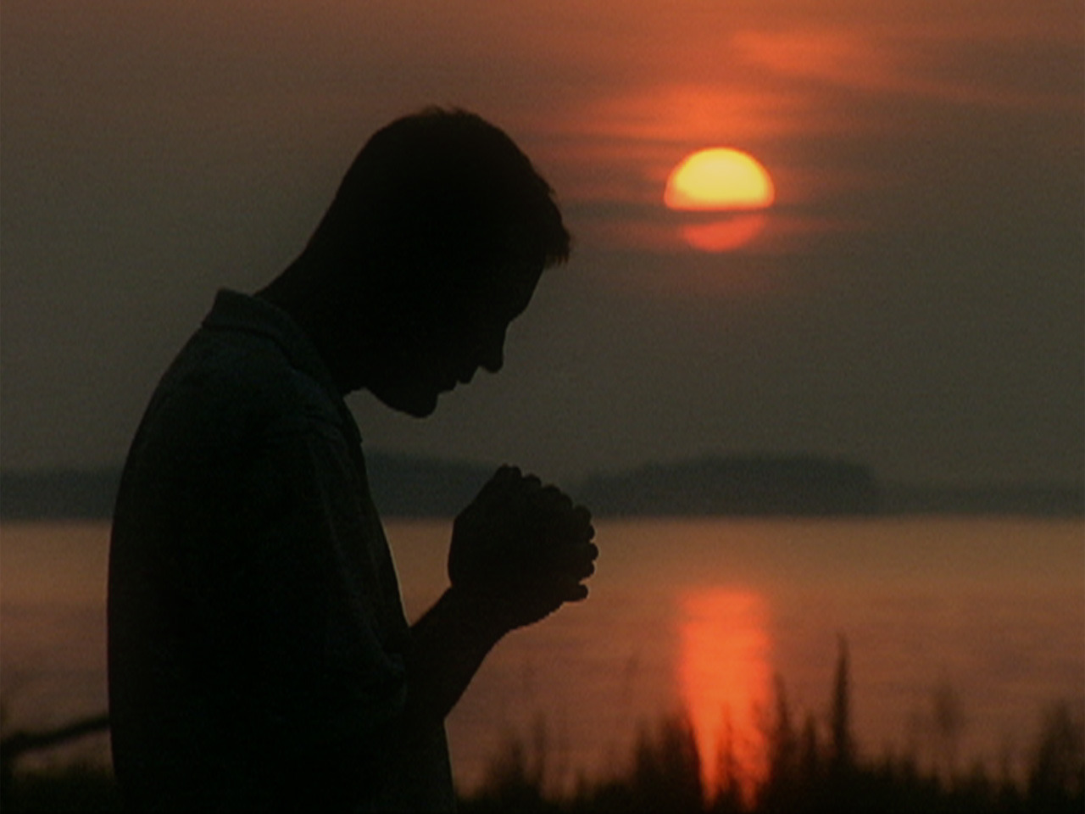
Healthcare Beliefs
Spirituality is often expressed through religious practices and provides a source of support and strength to deal with situations. However, spirituality does not necessarily include the attendance of church.

Slide 9
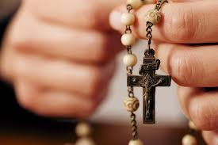
Healthcare Beliefs
Spirituality and religion are not the same. Spirituality is an individualized, personal set of beliefs that changes throughout an individual’s life.

Slide 10
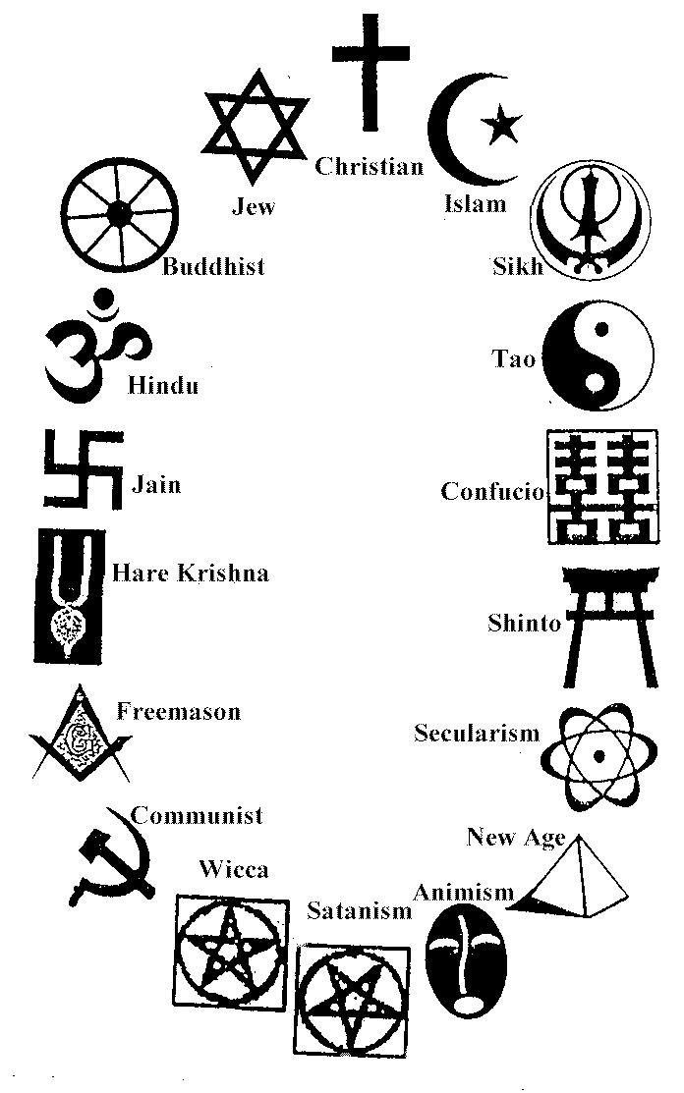
Healthcare Beliefs
Religion-an organized system of beliefs in a higher power and associated with a particular form or place of worship.

Slide 11
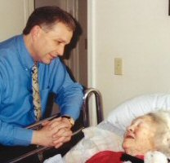
Healthcare Beliefs
Common religious beliefs: Baptist, Buddhism, Christian Scientist, Episcopal, Hindu, Islam, Jehovah’s Witness, Judaism, Lutheran, Methodist, Mormon, Catholic, Orthodox, 7th Day Adventist.
In support of spiritual beliefs, the health care worker should allow for privacy during clergy visits.

Slide 13
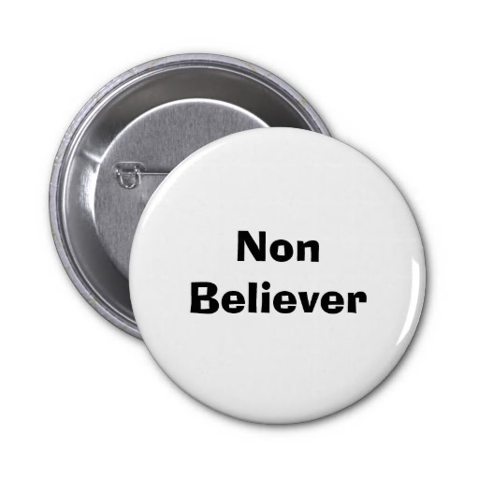
Healthcare Beliefs
Atheist-non-believer; does not believe in any deity.

Slide 14
Healthcare Beliefs
Agnostic-believes that the existence of God cannot be proved or disproved; doesn’t have any religious practices.

Slide 15
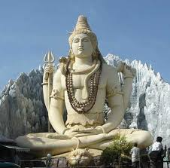
Healthcare Beliefs
In order to fulfill spiritual and religious needs, the health care worker must ask the patient questions and determine their personal beliefs.
Ex.: Joe’s new patient tells him that he is Hindu. Joe should ask him if there is anything he should know about his spiritual needs in order to provide him the best of care.

Slide 16
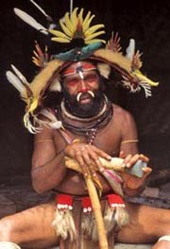
Healthcare Beliefs
The health care worker must allow patients to express their beliefs, practice rituals, or follow a special diet as long as it will not cause any harm.

Slide 17
Respect Cultural Diversity
We should respect cultural diversity by regarding each person as a unique individual. The health care worker must be aware of the needs of each individual in order to provide total care.
The healthcare worker must:
Be a willing listener.
Support spiritual and religious practices.
Respect symbols and books.
Provide privacy during clergy visits.
Refrain from imposing their beliefs on the patient.

