Slide 1
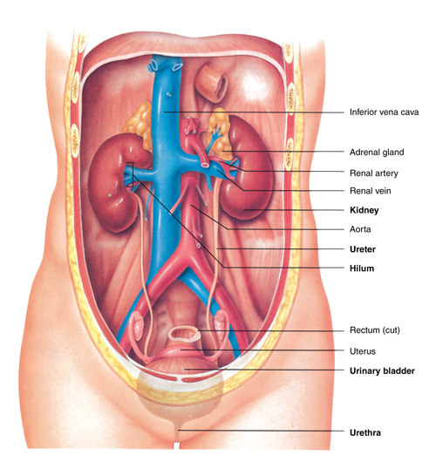
4.02 Understand the Functions and Disorders of the Urinary System

Slide 2
4.02 Understand the functions and disorders of the urinary system
Essential Questions
What are the functions of the urinary system?
What are some disorders of the urinary system?
How are disorders of the urinary system treated?
How do you relate the body’s hormone control to the urinary system?

Slide 3
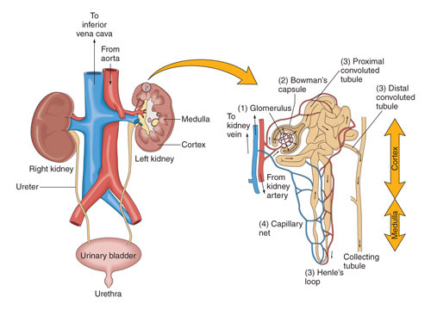
Understand the functions of the urinary system
Functions:
1. Excretion
2. Formation of urine
3. Fluid and electrolyte balance
4. Elimination of urine

Slide 4
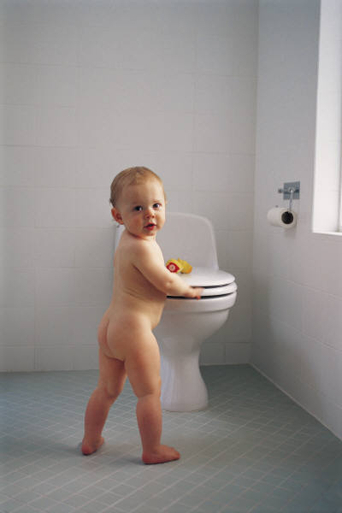
Understand the functions of the urinary system
Excretion
The process of removing nitrogenous waste material, certain salts and excess water from the blood.

Slide 5

Understand the functions of the urinary system
Filtration
Reabsorption
Secretion

Slide 6
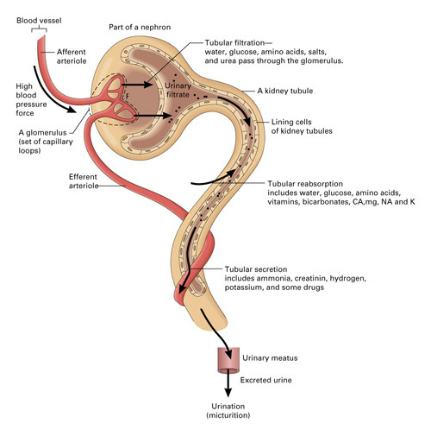
Filtration
Blood from renal artery enters glomerulus
High pressure in glomerulus forces fluid into Bowman’s capsule, where it is filtered
*The filtrates include water, glucose, amino acids, some salts and urea; blood and proteins should not be part of the filtrates.

Slide 7
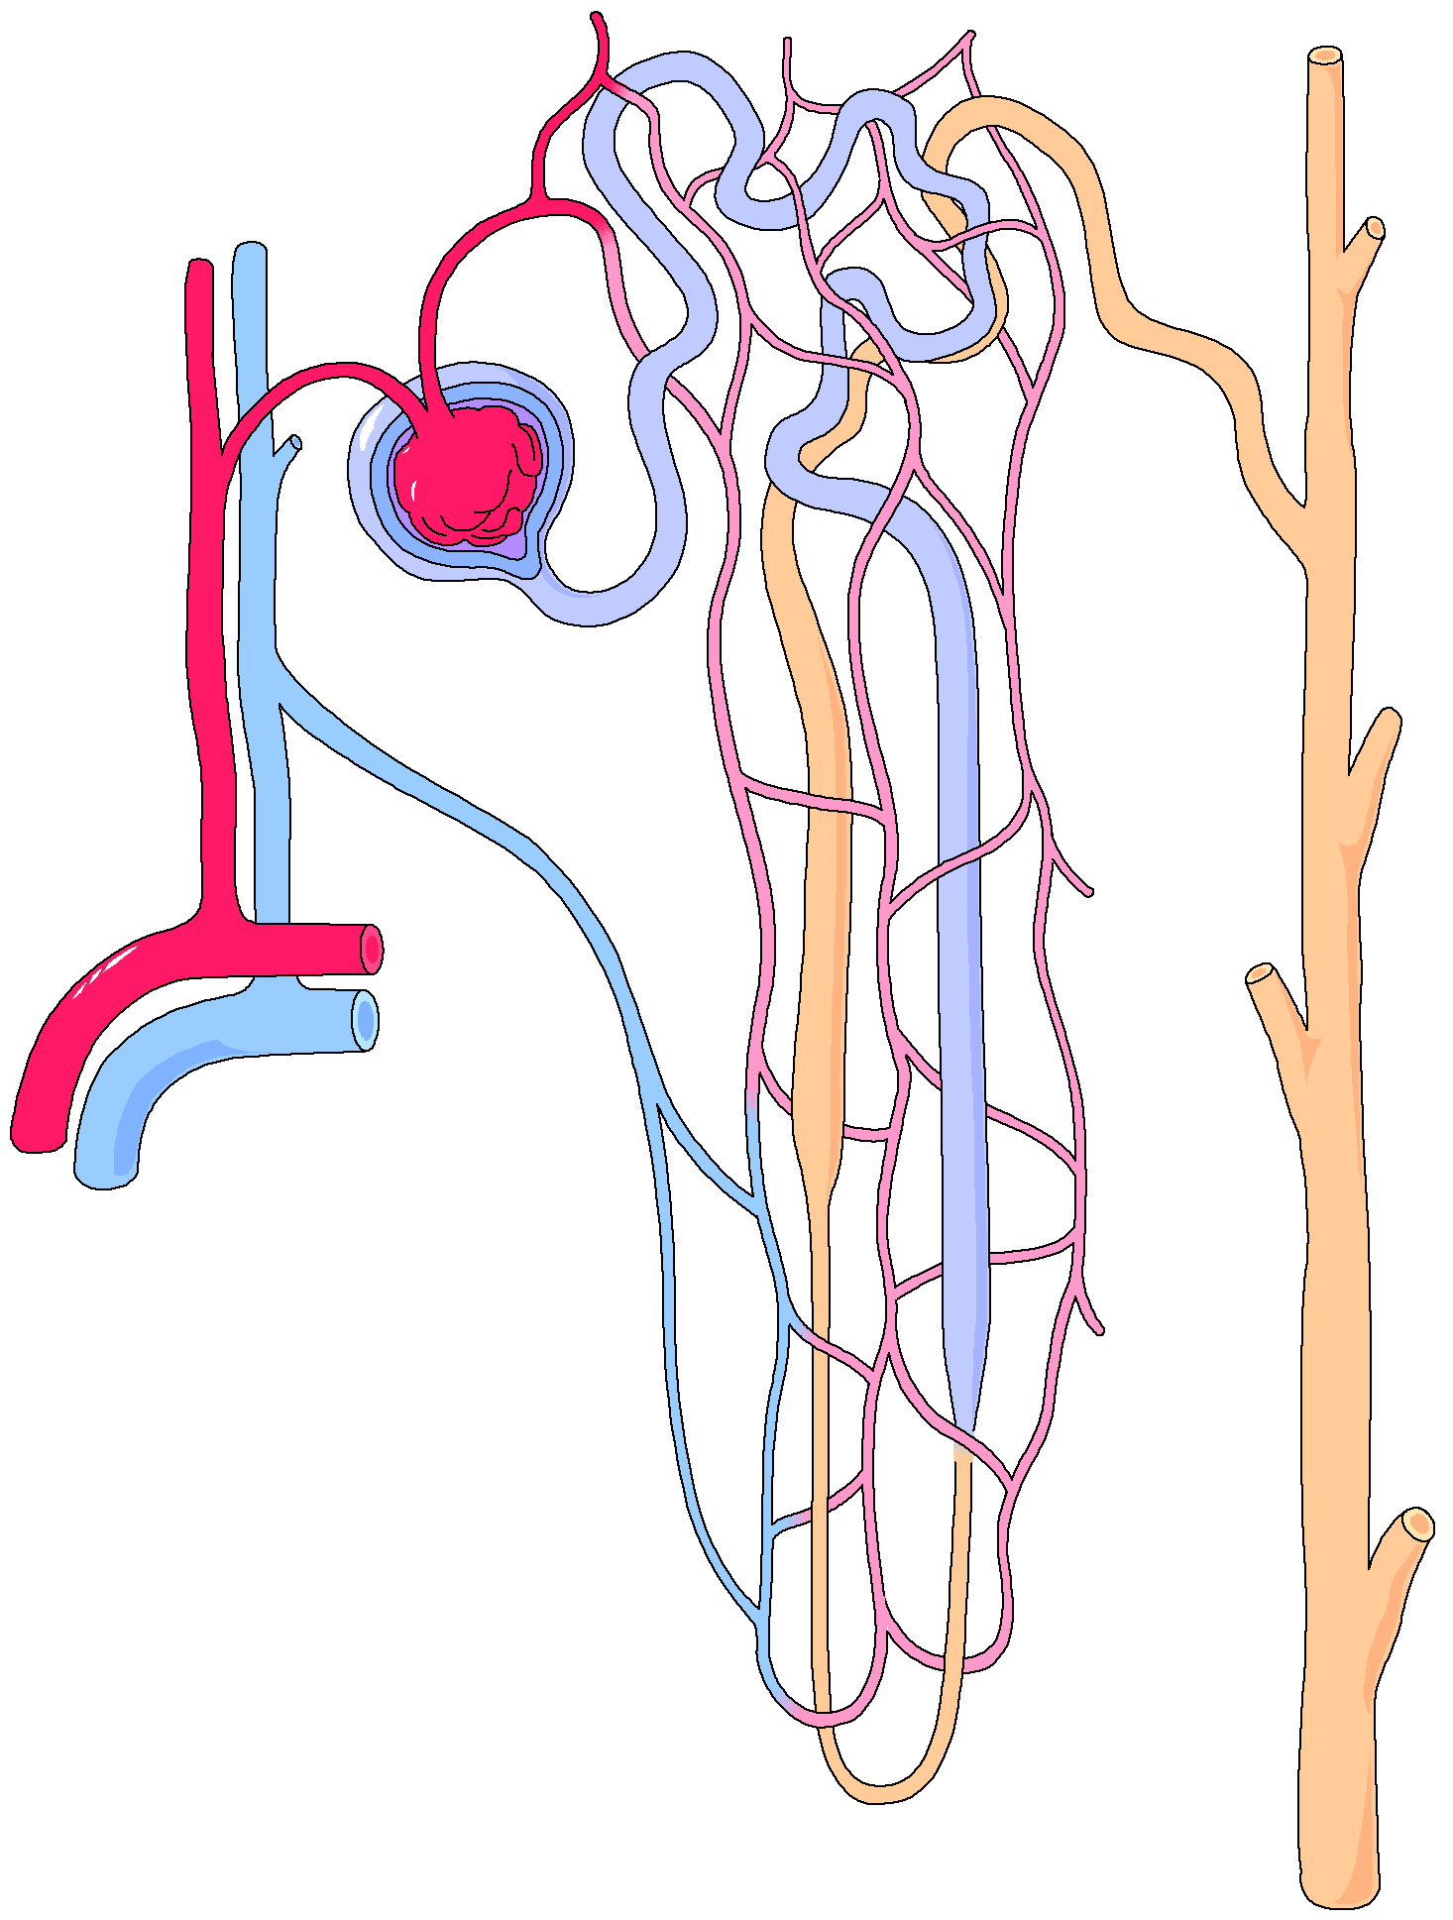
Filtration
Bowman’s capsule filters out 125cc of fluid/min.
…how many cc’s per hour is this?
As the filtrate continues through nephron, 90% of water is reabsorbed—what would happen if reabsorption here failed?

Slide 8
Reabsorption
*Reabsorption-useful substances (water, glucose, amino acids, vitamins, calcium, sodium, potassium) from the filtrate go into the capillaries to be used by the body. The anti-diuretic hormone (ADH) may become inhibited by certain drugs and alcohol and this will affect the reabsorption process by causing excessive urination (polyuria). DEHYDRATION may occur from polyuria and the failure of the body to reabsorb useful substances
4.02 Understand the functions and disorders of the urinary system
8

Slide 9
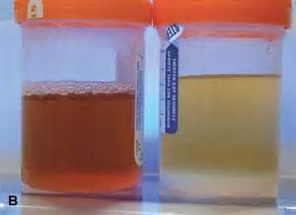
Reabsorption
*Dehydration-occurs when the amount of water leaving the body is greater than the amount being taken in.
Causes: Dehydration occurs because there is too much water lost, not enough water taken in, or most commonly, a combination of the two. (Diarrhea, vomiting, sweating, inability to drink fluids, burns)
*Symptoms-dry mouth, thirst, muscle cramps, nausea, vomiting, light-headed, decreased urine, dark colored urine
4.02 Understand the functions and disorders of the urinary system
9

Slide 10
Reabsorption
What substances are reabsorbed?
Where do they go?
If blood levels of certain substances are high, the substances will not be reabsorbed.
How does this help maintain homeostasis?

Slide 11
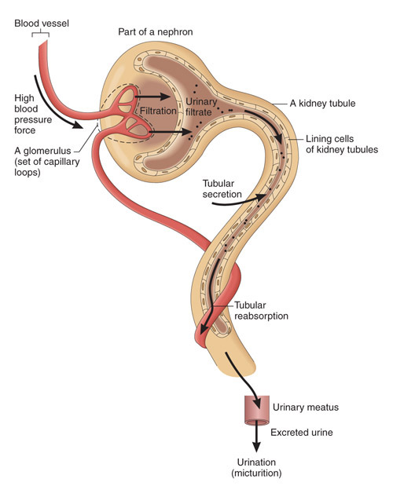
*Secretion
What is *secretion?
*Excessive substances (wastes-ammonia, sodium, hydrogen, potassium, some drugs) are secreted (transported) into the tubules and then into the urine for ELIMINATION.
Describe how this process is the opposite of reabsorption….

Slide 12
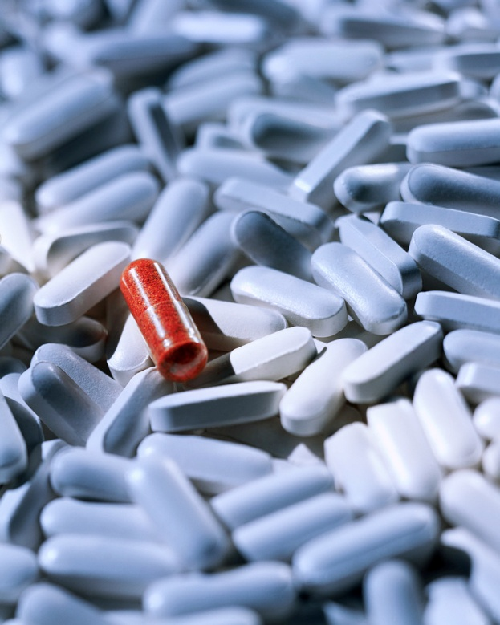
Secretion
What substances are secreted into the collecting tubules?

Slide 13
Understand the functions of the urinary system
Fluid and electrolyte balance
Electrolytes are selectively secreted to maintain body’s acid-base balance.
  What are electrolytes?>>>
  What do they do?
  Regulate nerves, muscles,
  control fluid balance in the body
  and maintain acid-base balance
  What is the relevance to health?

Slide 14
Understand the functions of the urinary system
Fluid and electrolyte balance
Chemical control
  ADH – Antidiuretic hormone
  Aldosterone

Slide 15
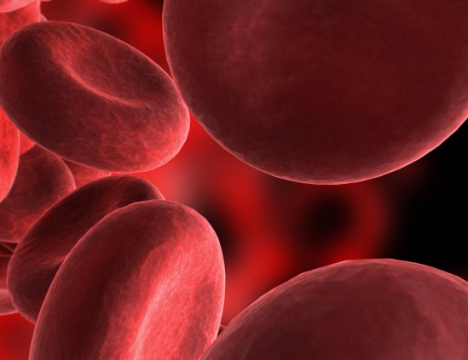

Understand the functions of the urinary system
Fluid and electrolyte balance
Chemical control
ADH helps to maintain balance of body fluids
The amount of ADH produced is related to the level of body hydration

Slide 16
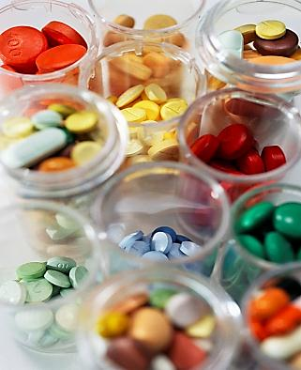
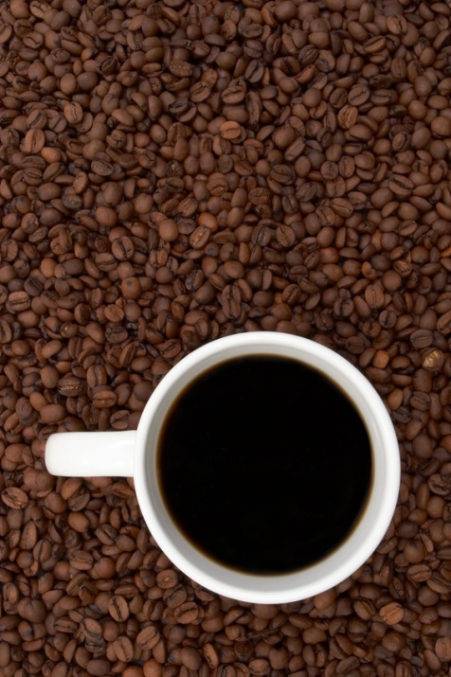
Understand the functions of the urinary system
Define “dilute urine”
What are *diuretics? Increase urinary output by inhibiting the reabsorption of water
What effect do they have on the production of urine? *Increases urine production
Give examples of substances that have diuretic effects.
Caffeine, alcohol, diuretic medications
*May be used to treat hypertension, congestive heart failure, etc.

Slide 17
Understand the functions of the urinary system
Fluid and electrolyte balance
Chemical control
Aldosterone
Where does it come from? Adrenal cortex
What does it do? Promotes excretion of potassium and hydrogen and the reabsorption of sodium.
Aldosterone release is the result of the renin-angiotensin system. What does this mean?
These hormones work together to regulate blood pressure and water balance. A patient may be given a Renin type blood pressure medicine to help control hypertension

Slide 18
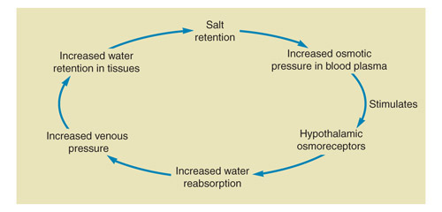
Understand the functions of the urinary system
Fluid and electrolyte balance
What effect does this cycle have on your blood pressure?

Slide 19
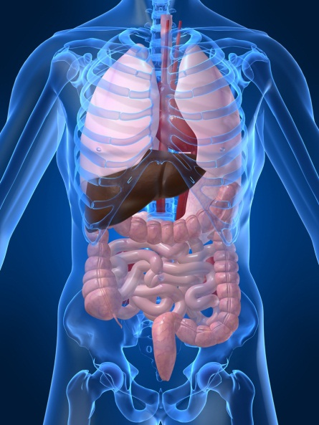
Understand the functions of the urinary system
Fluid and electrolyte balance
Nervous control
How does the nervous system control urinary secretions? Direct impulses to the blood vessels that lead to the kidneys.
What other systems are involved in the production and excretion of urine?

Slide 20
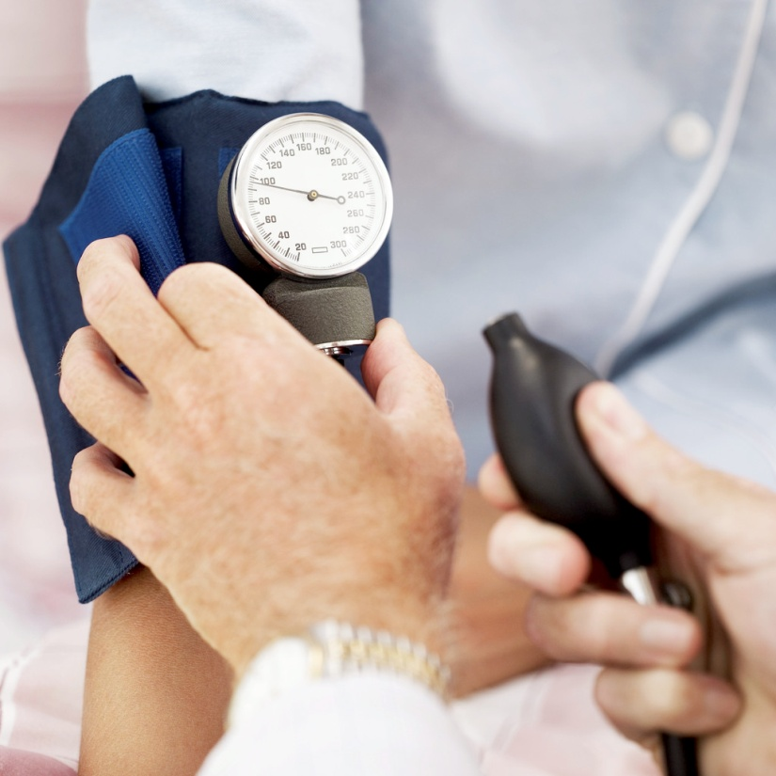
Understand the functions of the urinary system
review
What do you predict will happen to blood pressure when the blood volume increases?
What if blood
volume decreases?

Slide 21

Understand the functions of the urinary system
review
If more water is reabsorbed back into the body---what will happen to urine concentration?
(more or less concentrated?)

Slide 22
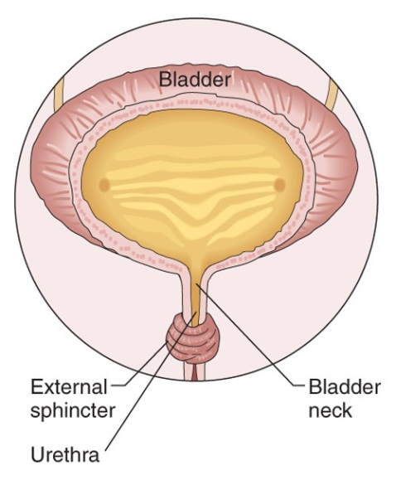
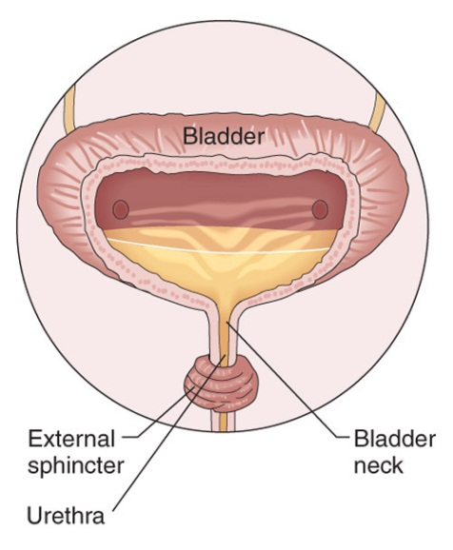
Understand the functions of the urinary system
Elimination of urine
What causes the bladder to empty? Bladder fills and urinary meatus relaxes.
What can prevent urination? Certain disease processes (multiple sclerosis, certain meds, vaginal delivery, etc)
How is urinary retention treated?

Slide 23
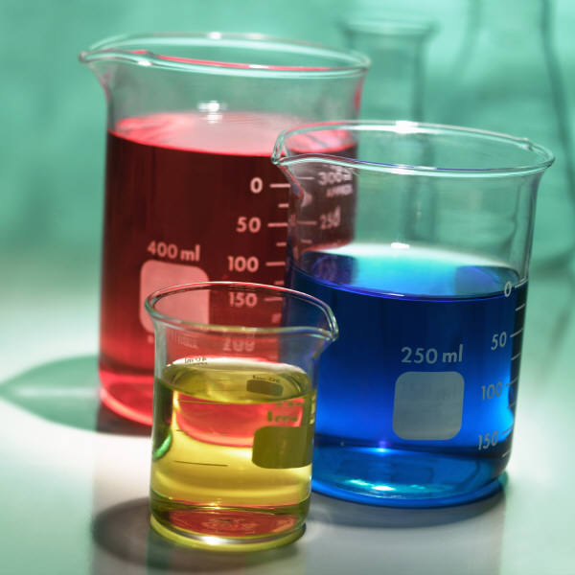
Understand the functions of the urinary system
Elimination of urine
Urinary output
Average urinary output = 1500 ml per day
*How many ounces is this?
(1 ounce = 30 ml)
What effects the color of your urine?

Slide 24
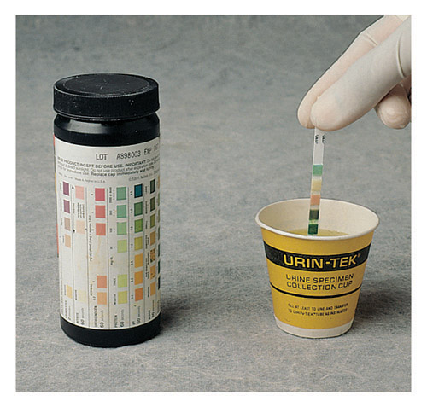
Urinalysis
An examination of urine
What does normal urine look like?
What constitutes an abnormal urinalysis?
Ammonia
Is a NORMAL finding

Slide 25
Urinalysis
What could the presence of blood in urine indicate?
What is the medical term for this condition?
*Hematuria
*Caused by improper filtration

Slide 26
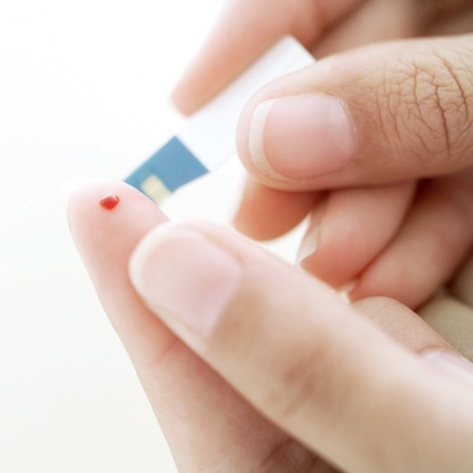
Urinalysis
Where would excess glucose show up?
What does this mean?

Slide 27
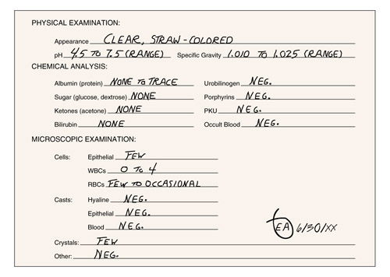
Urinalysis

Slide 28
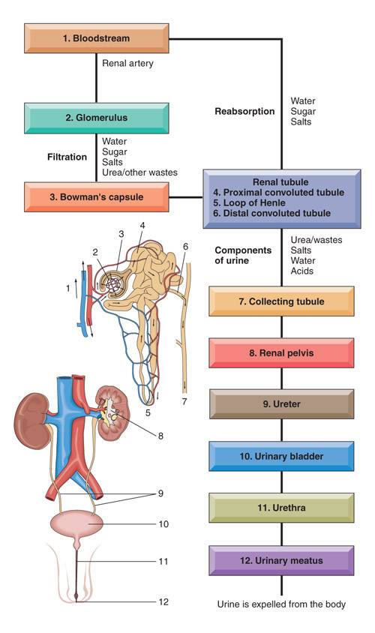
Know the flow of urine!
Review urine formation, electrolyte exchange, and some factors that effect urine volume.
4.02 Understand the functions and disorders of the urinary system
28

Slide 29
Disorders of the urinary system

Slide 30
Disorders of the urinary system
*Cystitis
What is cystitis?
(cyst= medical term for ____ +itis =___ )
*Most common cause: E. Coli
What are the major *symptoms of cystitis?
Dysuria, polyuria, urinary frequency, abdominal pain
*Causes: improper hygiene

Slide 31

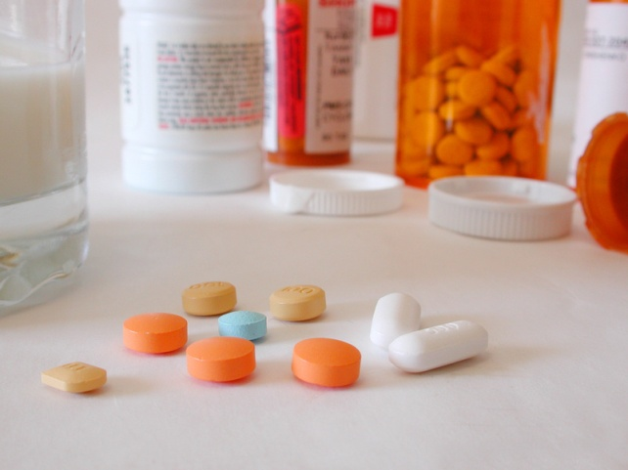
Disorders of the urinary system
Cystitis
More common in females—Why ??
Shorter urethra
Rx=
antibiotics

Slide 32
Disorders of the urinary system
Disease which injures the glomerulus; usually results from a bacterial infection (strep throat).
What will happen as a result of damaged glomeruli?
Kidney failure could
occur
Glomerulonephritis

Slide 33
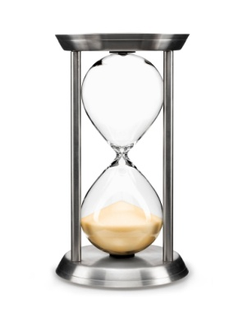
Disorders of the urinary system
Glomerulonephritis
Two types:
  Acute
  Chronic
Define these terms.
How do these terms relate to glomerulonephritis symptoms?
What is the prognosis for each?
Acute-recovery usually occurs
Chronic-permanent damage withdiminished function of kidney

Slide 34
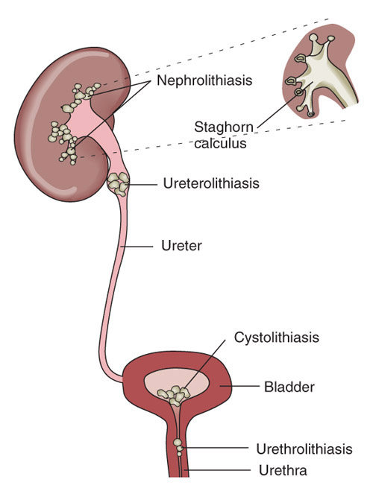
Disorders of the urinary system
*Renal calculi
Also known as nephrolithiasis
nephro lith iasis
What are renal calculi made of?
Calcium and uric acid
What are the *symptoms?
Extreme flank pain, nausea,
vomiting, burning, frequent
urination, chills, fever, weakness,
hematuria, hydronephrosis
(distention of the kidney due to
accumulation of fluid)

Slide 35
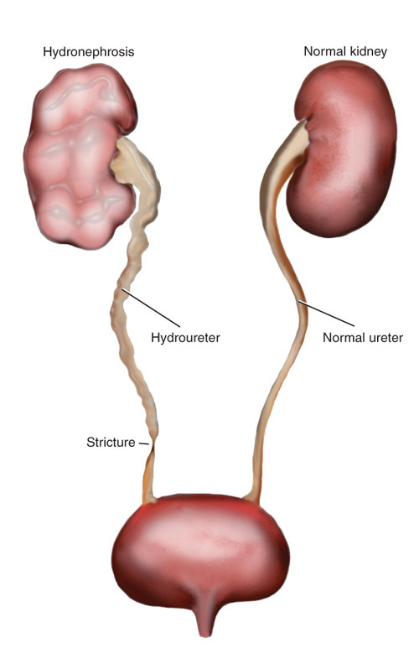
Disorders of the urinary system
*Renal calculi-can obstruct the flow of urine.
*What will happen if the ureters are blocked?
Severe flank pain and hydronephrosis

Slide 36
Disorders of the urinary system
Renal calculi
How is it treated?
Fluid to increase output, medication to dissolve the stone, urethroscope or lithrotripsy

Slide 37
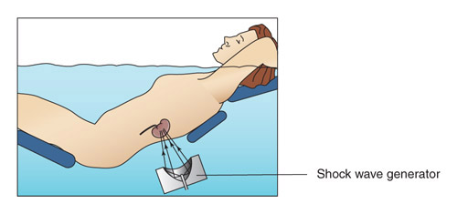
Disorders of the urinary system
Renal calculi
How does lithotripsy work?
Is it a cure?

Slide 38
Disorders of the urinary system
*Renal failure
*Acute
  *What causes it? Nephritis, shock, injury, bleeding, heart failure, poisoning
  *What are the symptoms? Oliguria is an early sign of failure (decreased urine), anuria (absence of urine), uremia (toxicity), headache, dyspnea, nausea, vomiting, coma, death

Slide 39
Disorders of the urinary system
Renal failure
Chronic-gradual loss of nephron function
May be no symptoms in early stages, urinalysis may reveal proteinuria
Why would protein be present in the urine? The filters in the kidney are damaged
Why is this not normal? The kidney’s/filters typically do not allow a large amount of protein to pass through.

Slide 40
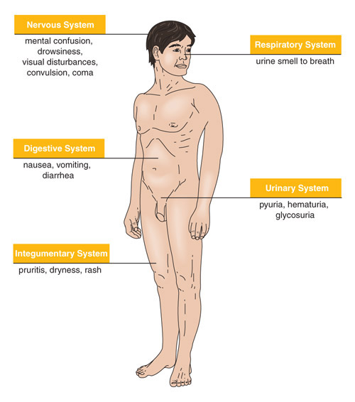
Disorders of the urinary system
Renal Failure
Chronic kidney disease leads to a buildup of fluid and waste products in the body.
How are these systems affected by renal failure?

Slide 41
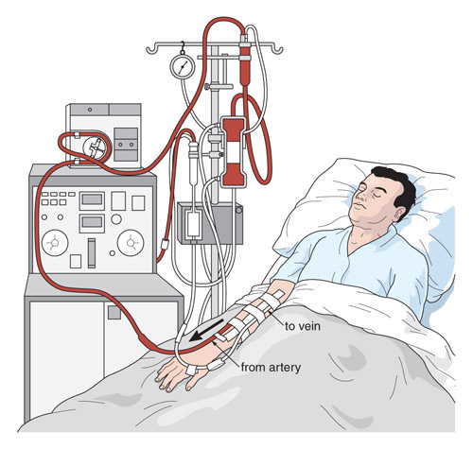
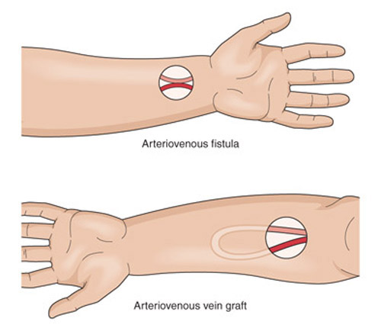
Disorders of the urinary system
*Renal Failure
*Treatment:
  *Hemodialysis
  Purifying/FILTERING the blood by passing it through a thin membrane (semi-permeable membrane) and into a solution (dialysate); the wastes are removed.
  Treatment schedule: 2-3 times a week; the treatment takes
  2-4 hours

Slide 42
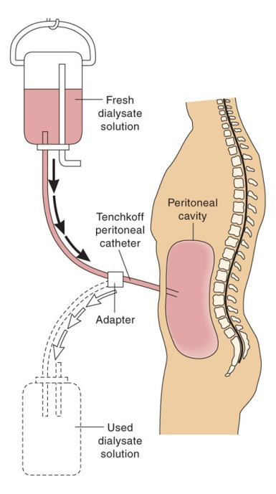
Disorders of the urinary system
Renal Failure
Compare the treatment of acute and chronic renal failure.

Slide 43

Disorders of the urinary system
How does hemodialysis mimic
glomerular function?

Slide 44

Disorders of the urinary system
Renal transplant
What is involved in this treatment option?
Making sure that the kidney is a match; a family member is usually the best match.
When does a patient get a transplant?
When there is renal failure involving both kidneys and the client has been on dialysis for a long period of time.

Slide 45
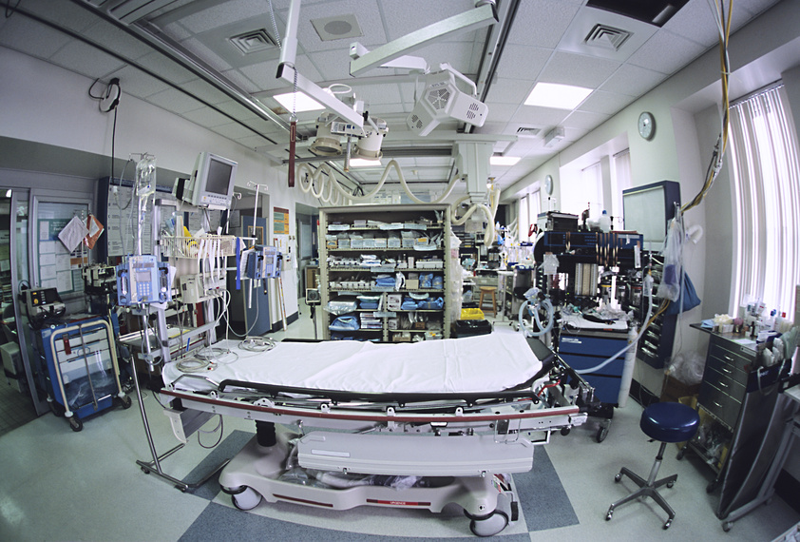
Disorders of the urinary system
Renal transplant
What is the major complication of renal transplantation?
Rejection

Slide 46
Additional Terms you need to know:
Enuresis-inability to hold urine, results in bedwetting.
*Anuria-no urine
Micturate-to urinate
Nephralgia-kidney pain
Neurogenic bladder-nerve damage to the bladder
Nocturia-frequent urination at night
*Polyuria-excessive urination

Slide 47
Additional Terms you need to know:
Urinary catheterization-tube inserted in bladder to drain urine
Urinary retention-the inability to urinate
*Incontinence-involuntary urination; loss of control
Urinate-to empty the bladder
Void-to urinate

Slide 48
4.02 Understand the functions and disorders of the urinary system
Essential Questions
What are the functions of the urinary system?
What are some disorders of the urinary system?
How are disorders of the urinary system treated?
How do you relate the body’s hormone control to the urinary system?

