Slide 1
3.06 Understand the functions and disorders of the integumentary system

Slide 2
Essential Questions:
What are the functions of the integumentary system?
What are some disorders of the integumentary system?
How are integumentary system disorders treated?
How do you relate the integumentary system to the body’s communication systems?

Slide 3
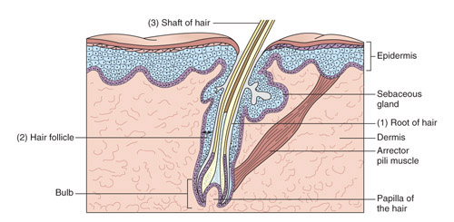
Functions of the integumentary system
What are the functions of the skin?
What structures are involved in these functions?
1
3
5
7
4
2
6

Slide 4
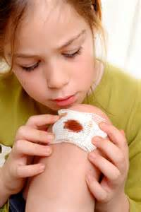
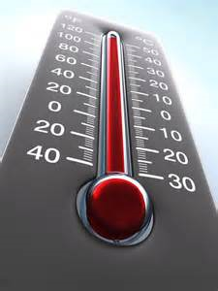

Functions of the integumentary system
Epidermis
  *FUNCTIONS
  *Protection-serves as barrier against bacteria & chemicals; protects deeper, underlying structures
  Screens out harmful ultra-violet radiation contained in sunlight.
  *Regulates body temperature through evaporation of perspiration
  Manufactures Vitamin D
  *Contains sensory receptors for hot, cold, pain, touch
  *Absorbs certain drugs and chemicals (creams for rashes, heart meds, etc.)

Slide 5

Functions of the integumentary system
Epidermis
  Why are some people dark and others fair?
  Can that be changed?

Slide 6
Functions of the integumentary system
*Dermis
*Functions:
  Contains blood vessels that *regulate body temperature, *stores glucose, water, salts, *contains nerve/pain receptors, hair follicles, oil and sweat glands, fat cells
  Why is this important to your health?

Slide 7
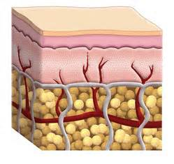
Functions of the integumentary system
Subcutaneous layer
  Hypodermal layer
  Hypo- dermal
  What are the benefits of the subcutaneous layer of skin? Contains about one-half of the body’s stored fat (adipose tissue); insulates the body; when one eats too much, this layer becomes larger.

Slide 8
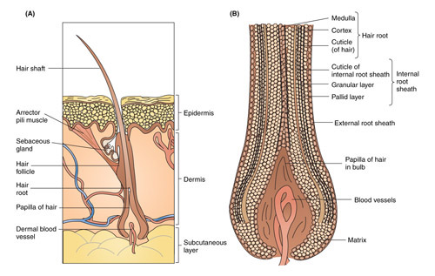
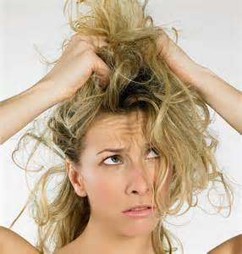
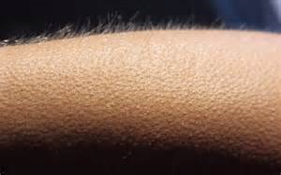
Functions of the integumentary system
Hair
  What is the function of hair? Protection and regulates temperature
  What factors influence hair type and color? The length, thickness, type and color will vary with the different parts of the body and different races.
  What happens to your hair when you are cold? Why? The arrector pili muscle contracts and produces a small amount of oil; hairs may also stand up.

Slide 9
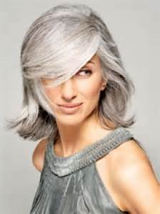
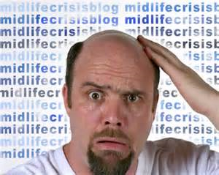
Functions of the integumentary system
Hair
  What happens to your hair when you age? The color pigment is replaced with air and the hair turns gray or looks white.
  Alopecia-baldness; the normal hair is replaced by short, transparent hair.
9

Slide 10
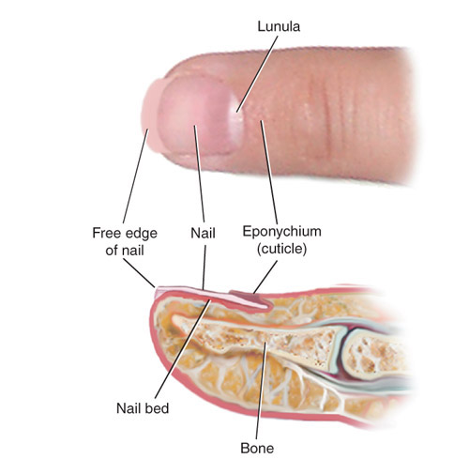

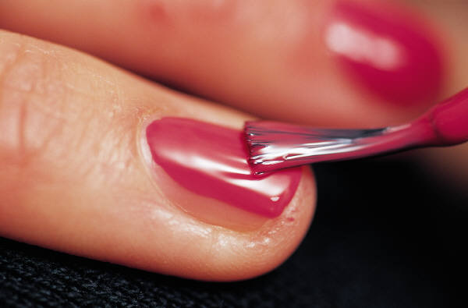
Functions of the integumentary system
Nails
  Not just a pretty color!
  What does the condition of a person’s nails tell about their general health? Can indicate certain diseases. Ex: white nails-liver disease, nail bed is red-heart disease, pale nail bed-anemia, yellow & thick nails-lung disease, bluish nails-hypoxia.

Slide 11
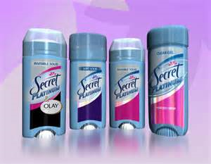
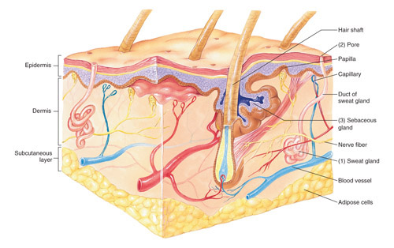
Functions of the integumentary system
Glands
  Sudoriferous glands
  Why does sweat smell bad? The perspiration produced by the axillary (armpit) sudoriferous glands interacts with the bacteria on the skin; wearing anti-perspirants can minimize the odor, deodorant soaps can kill the bacteria ; the nervous system control the sudoriferous glands.

Slide 12
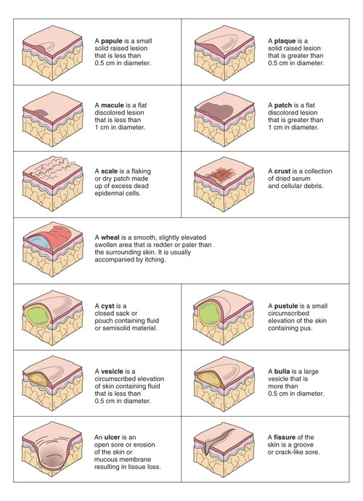
Functions of the integumentary system
Glands
  Sebaceous glands
    What role do sebaceous glands have in relation to pimples? The sebum (oil) becomes hard and plugs up the opening of the gland, the area then fills with leukocytes.
Pimple
3.06: Understand the functions and disorders of the integumentary system
12

Slide 13
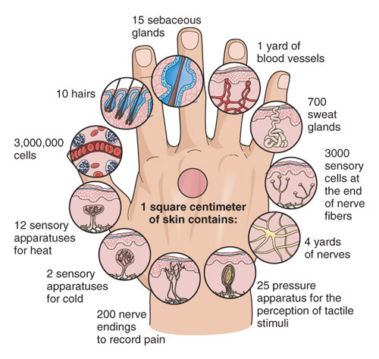
Functions of the integumentary system
review
What are the functions of the skin?
What structures are involved in these functions?
1
3
5
7
4
2
6

Slide 14
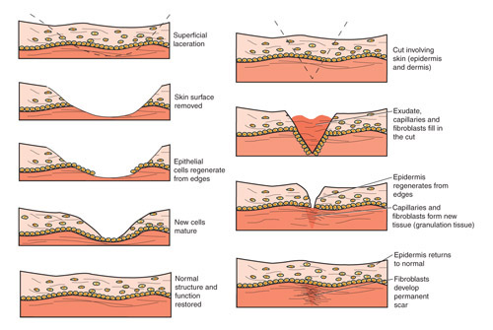
Functions of the integumentary system
The skin has remarkable ability to heal itself.
How does this happen? The stratum germinativum is constantly reproducing itself so that it can repair itself if injured.

Slide 15
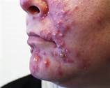
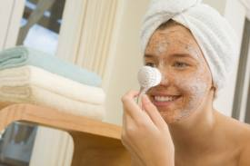
Disorders of the integumentary system
*Acne vulgaris: a common, chronic disorder of the sebaceous glands; excessive sebum is excreted, the sebum hardens and plugs the gland opening; the area fills with leukocytes and accumulates pus; occurs most often during adolescence.
Treatment: topical meds, antibiotics
Prevention: keep face clean, keep hands and hair away from face

Slide 16
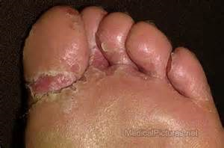
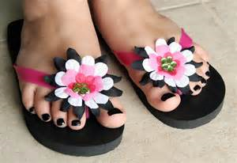
Disorders of the integumentary system
*Athlete’s foot-contagious fungal infection that infects the superficial skin layer causing skin eruptions; usually contracted in public showers.
Symptoms: some people have severe discomfort, others have only a few symptoms; blisters between the fingers or toes with cracking, scaling, itching.
*prevention: wear shower shoes in locker rooms; do not share towels; practice good personal hygiene

Slide 17
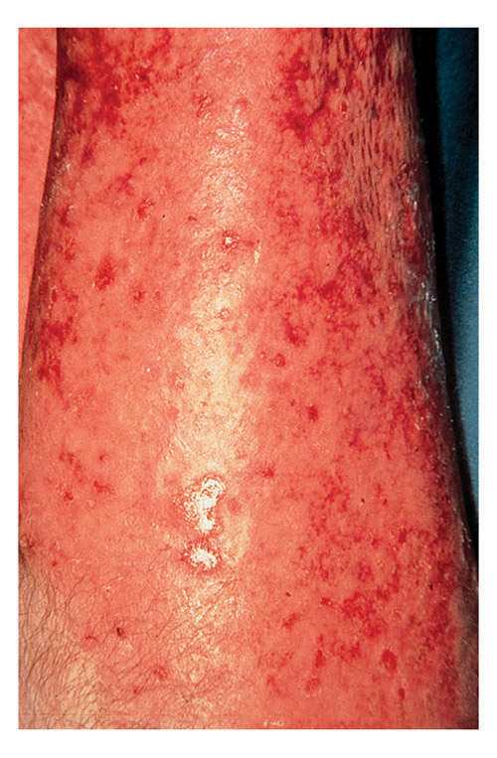
Disorders of the integumentary system
Burns:
First-degree
Second-degree
Third-degree

Slide 18
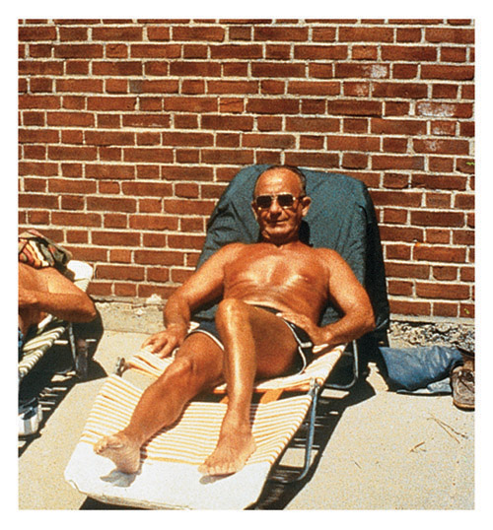
Disorders of the integumentary system
Burns:
*First-degree-involves only the epidermis.
*Symptoms: redness, swelling, pain
Treatment: cold water
superficial

Slide 19
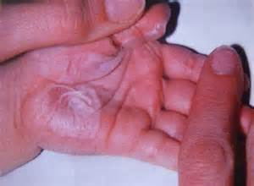
Disorders of the integumentary system
Burns:
*Second degree-epidermis and dermis.
*Symptoms: pain, swelling, redness, blisters.
Treatment: pain meds, sterile dressings.
Partial thickness

Slide 20
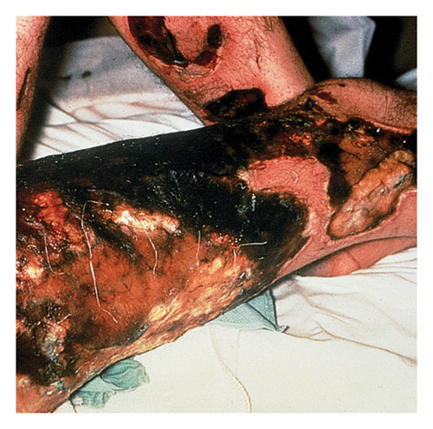
Disorders of the integumentary system
Burns:
Third-degree: complete destruction of the epidermis, dermis and subcutaneous layers.
Symptoms: loss of skin, eschar (blackened skin), possibly no pain
Treatment: may be a life-threatening situation; immediate hospitalization, prevention of infection, contracture, fluid replacement.
Full thickness

Slide 21
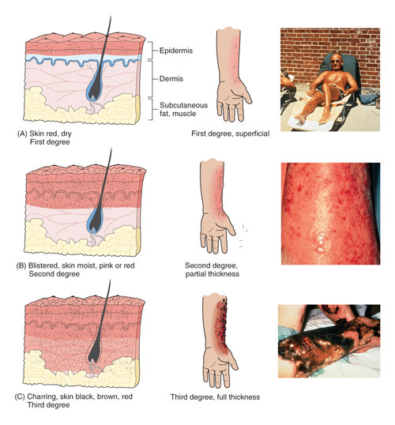
Disorders of the integumentary system
Burns:
Compare the different degrees of burns.
https://www.youtube.com/watch?v=CNQ_uW66LfU

Slide 22
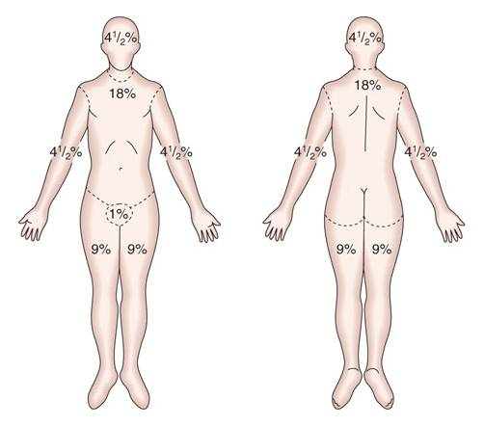
Disorders of the integumentary system
Burns:
Rule of Nines
Used to quickly assess percentage of body surface burned.
Can be used to determine extent of treatment needed.

Slide 23
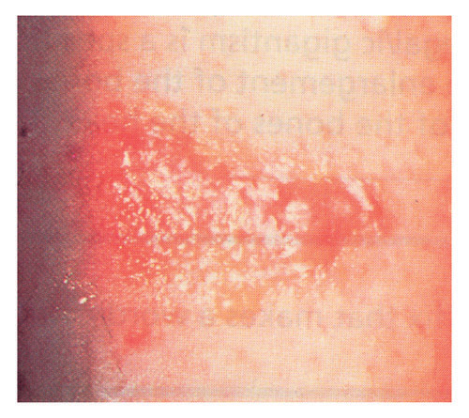
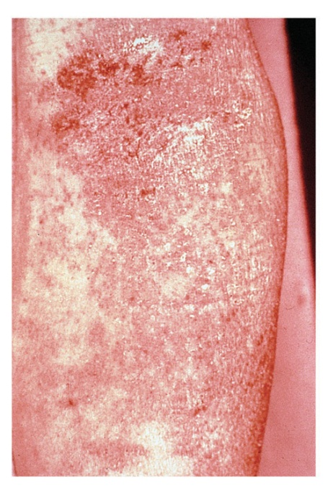
Disorders of the integumentary system
Dermatitis/Eczema
dermat- -itis
*Dermatitis-inflammation of the skin; the cause may be non-specific (allergic reaction, stress, exposure to chemicals)
Eczema-acute, chronic, non-contagious inflammatory skin disease
How are they different?
Treatment: remove the causative agent; topical ointments to alleviate the symptoms

Slide 24
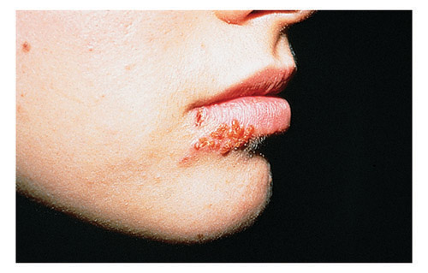
Disorders of the integumentary system
Herpes-viral infection that is usually seen as a blister
Herpes simplex virus
Two types of HSV:
HSV type 1-causes sores around the mouth and lips (cold sores/fever blisters)
HSV type 2-sores around the genitals or rectum
Symptoms: blisters that rupture and leave sores
How is it spread? Oral secretions, sexual contact
What is the prognosis? No cure; treat with
Acyclovir a anti-viral medication.

Slide 25
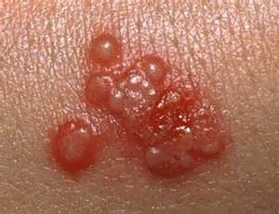
Disorders of the integumentary system
*Herpes simplex 2-a sexually transmitted viral infection that is usually seen as a blister or sores around the genitals or rectum
If a pregnant woman has symptoms
when the delivery date arrives, the baby may become infected when passing through the vagina. A c-section may be performed.
25

Slide 26
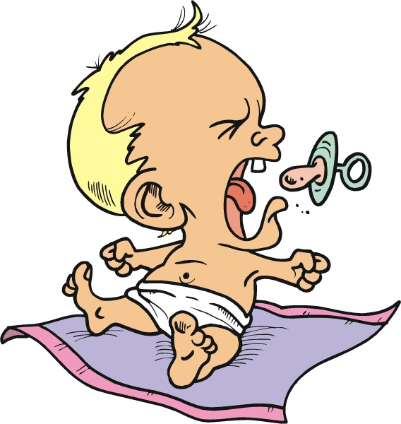
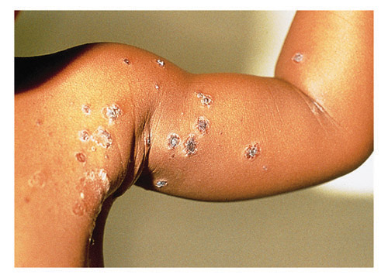
Disorders of the integumentary system
Impetigo-acute, inflammatory and contagious skin disease seen in babies and young children
What two bacteria cause impetigo? Staphylococcus or streptococcus organism
Symptoms: vesicles that rupture and develop yellow crusts
What are some risk factors in contracting impetigo? Sharing toys, bedding, towels, etc.
How is it treated? topical antibacterial cream or oral antibiotics

Slide 27
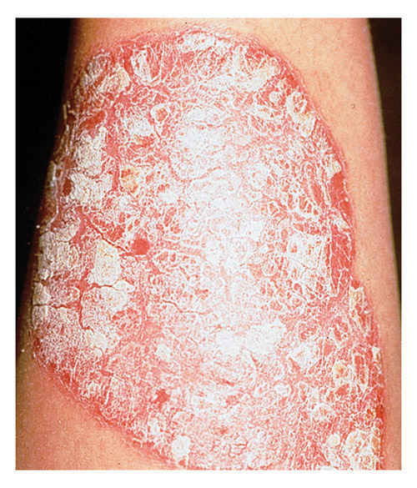
Disorders of the integumentary system
Psoriasis-chronic inflammatory skin disease characterized by the development of dry reddish patches covered with silvery-white scales; affects skin over elbows, knees, shins, scalp, lower back .
Describe this picture.
Who is likely to have psoriasis? More common in adults
What is the treatment? Moisturizers

Slide 28
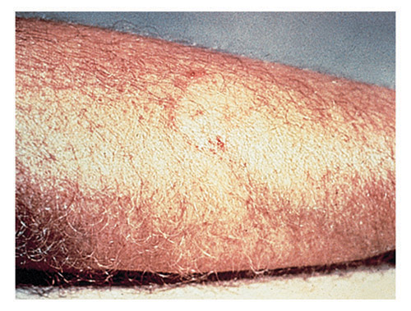
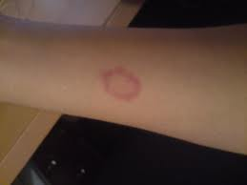
Disorders of the integumentary system
Two examples of ringworm
How would this be diagnosed?
Ringworm-highly contagious fungal infection; raised, itchy, circular patches with crusts
How is it spread? Skin-to-skin contact with a person or animal, sharing towels, sports equipment
What causes ringworm? fungus
What is the medical term? tinea
How is it treated? Antifungal meds

Slide 29
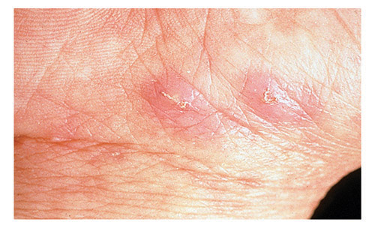
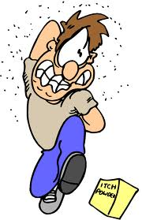
Disorders of the integumentary system
Scabies- a condition of very itchy skin caused by tiny mites that burrow into your skin
Is it contagious? spread by close, physical contact, sexual contact, sharing towels, bed sheets
How is it treated? It will not go away on its own, special med is needed

Slide 30
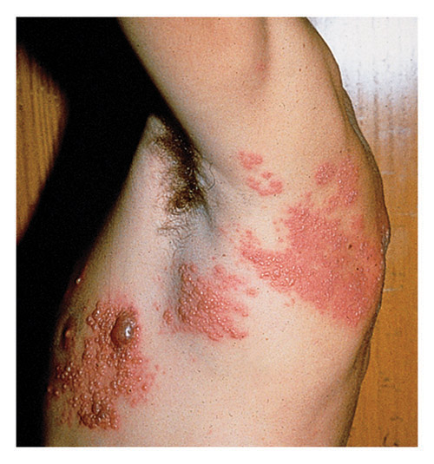
Disorders of the integumentary system
Shingles-skin eruption due to a virus infection of the nerve endings
What is the cause of shingles?
Caused by the same virus that causes chicken pox (herpes zoster)
Is it contagious? Yes, can be spread to people who have not had chicken pox
Who is most at risk? People who have had chicken pox, 50 or older, weaken-ed immune system
How is it prevented? vaccine

Slide 31
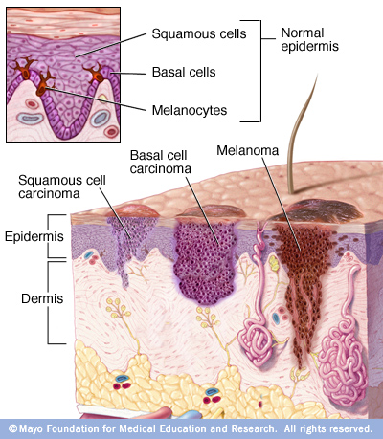
Disorders of the integumentary system
Skin cancer-most common type of cancer in people
What are the risk factors for developing skin cancer?
Exposure to ultraviolent light
How can it be prevented?
Limit exposure to direct sunlight
Three types:
  Basal cell carcinoma
  Squamous cell carcinoma
  Malignant melanoma

Slide 32
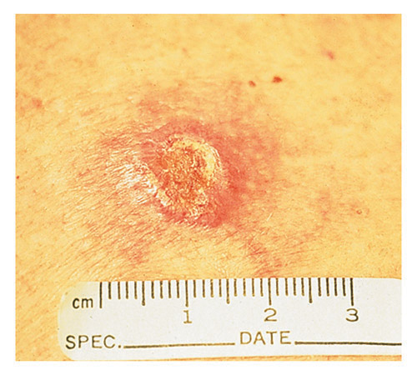
Disorders of the integumentary system
Skin cancer
Basal cell carcinoma-the most common and least malignant type of skin cancer.
Where does it usually form?
usually occurs on the face.

Slide 33
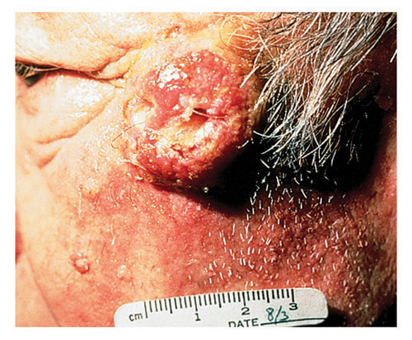
Disorders of the integumentary system
Skin Cancer
Squamous cell carcinoma-arises from the epidermis and occurs most often on the scalp and lower lip
How is squamous cell carcinoma different from basil cell carcinoma?
It grows rapidly and metastasizes to the lymph nodes

Slide 34
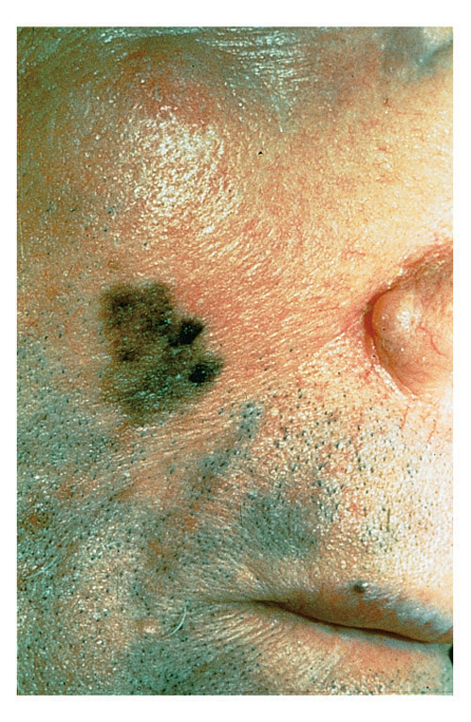
Disorders of the integumentary system
Skin cancer
*Malignant melanoma-occurs in melanocytes and metastasizes to other areas quickly; may appear as a brown or black irregular patch which occurs suddenly; a color or size change in a pre-existing mole or wart.
*Causes: exposure to ultraviolent light from the sun and tanning beds
  How are skin cancers treated?
  Surgery, radiation
https://www.youtube.com/watch?v=yhNL2k1ZV00

Slide 35
Disorders of the integumentary system
Skin lesions:-abnormal area on the skin
Discuss the characteristics of the different skin lesions.

Slide 36
Disorders of the integumentary system
Skin lesions: SEE PAGE 85 & 86 IN BOOK!
Compare these types of skin lesions.
Macule
Papule
Pustule
Ulcer
Vesicle

Slide 37

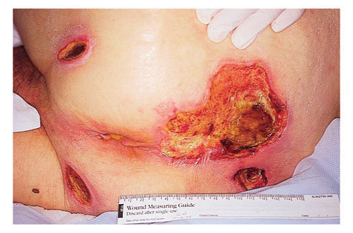
Disorders of the integumentary system
Skin lesion:
  Decubitus ulcer-aka bedsores; a deep loss of skin surface that may extend nto the dermis; occur when a person is constantly sitting or lying in the same position
How can they be prevented? Turning, repositioning frequently, relief of pressure on bony areas
How are they treated?
Remove damaged tissue, dressings, pain meds

Slide 38
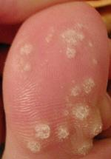
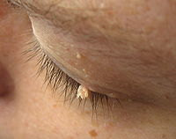
Disorders of the integumentary system
*Warts-small, rough, hard growth on the skin
*Causes: Human papilloma virus (there are over 100 kinds of HPV); YES, they are contagious!
Treatment: there are solutions to treat the warts but *they can recur after they are removed.
Can they be prevented? Hard to prevent, however, don’t share towels, wear shoes in public showers
There are many different types!

Slide 39
Essential Questions:
What are the functions of the integumentary system?
What are some disorders of the integumentary system?
How are integumentary system disorders treated?
How do you relate the integumentary system to the body’s communication systems?

